Slide 1
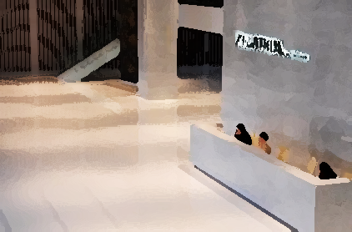



BG6
PVN
2026 PVN FME Q1工作報告
部門: (PVN)第六事業群-製造及營運管理中心-越南製造處-PVN1廠-FME部-自動化課
姓名: Phillip Nguyen
職等: 19
日期: 2026/03/15
FME
BG6 PVN

Slide 2

BG6
PVN
Self-Work Responsibilities
Operate and troubleshoot the laser engraving machine and the automatic glue dispensing machine
Learn, set up, operate, and troubleshoot AGV autonomous vehicles
Regularly check around the factory to ensure machines operate well and promptly handle any problems
Train OP on machine operation, including safe usage and prohibited actions
Maintain and service equipment and machines. Clean all equipment and surrounding areas to make sure everything follows 5S standards
Support training and guiding DL/new staff
Report machine progress to management and improve machine if necessary
FME
BG6 PVN

Slide 3
BG6
PVN
2026年度Q1工作成果
時間 | 工作成果
2025 Q4 | 1. Set up the laser engraving machine on the Donut F5-5R line (move the machine to a new position)
 | 2. Measure and report temperature monthly. Ensure all equipment stays within the standard temperature range.
 | 3. Handle abnormalities of the laser engraving machine and glue dispensing machine during operation.
2026 Q1 | 4. Install sensors and open/close clamps to prevent workers from placing products in the wrong position on the UX7 F5-5K
 | 5. Set up routes and programs for AGV vehicles
 | 6. Train warehouse staff to use, operate, and handle simple troubleshooting for AGV vehicles
FME
BG6 PVN

Slide 4
BG6
PVN
工作成果詳述(改善成果)
♦ Set up the laser engraving machine on the Donut F5-5R line (move the machine to a new position)
Prepared tools and checked the new installation position Relocate the laser engraving machine and related equipment to the position specified by IE Installed and fixed the machine in the correct position Connect related equipment (cooling and exhaust machine) Connected power supply and related cables Check the I/O functions and safety door to ensure they are working properly, and verify that the laser focus is the same as the original position Run a test engraving on a product to check if the engraving matches the original drawing
Training session at the Automation Center
PLC task from Tom and Max
My PLC practice
FME
BG6 PVN

Slide 5
BG6
PVN
工作成果詳述(改善成果)
♦ Measure and report temperature monthly. Ensure all equipment stays within the standard temperature range
- Checked the temperature of machines and related equipment in the production area
- Used a temperature measuring device to record the temperature of each machine
- Compared the measured temperature with the standard temperature range
- Recorded the results in the monthly temperature report
- If abnormal temperature is found, report to the supervisor and take necessary action
FME
BG6 PVN

Slide 6
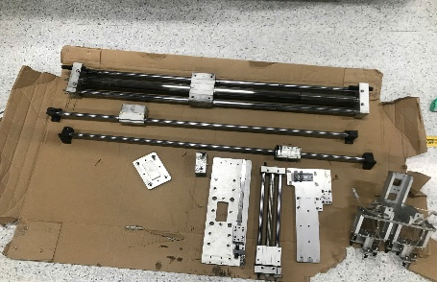
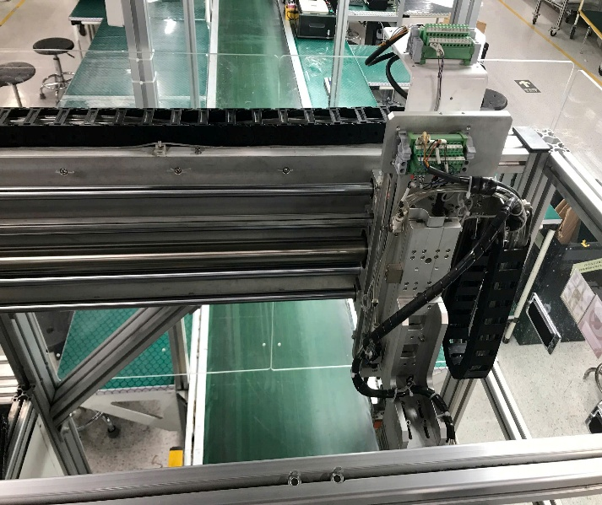
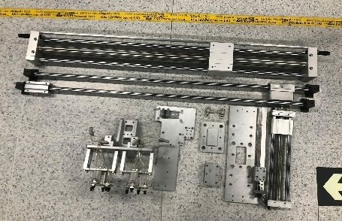
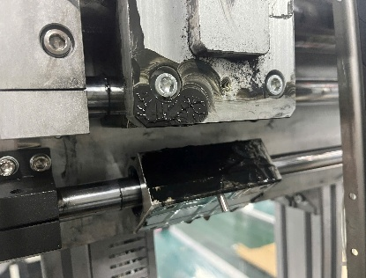
BG6
PVN
Detailed Description of Work Results
♦ Install sensors and open/close clamps to prevent workers from placing products in the wrong position on the UX7 F5-5K
Issue: Workers often make operation mistakes on this production line. Since the product is a square block with similar sides, it is easy to confuse the faces. If the product is placed in the wrong position, the laser engraving will be done in the wrong location, which can damage the product case
Action:
- Install a photoelectric sensor on the open/close clamp of the product jig
- Adjusted the sensor position to detect the correct product placement
- Connected the sensor to the control system.
- Test the sensor to ensure it works properly
Result:
The sensor can detect incorrect product placement and help prevent wrong operations by OP. As a result, product cases are no longer damaged due to incorrect engraving positions
Leveling cylinder stroke: Manually test the cylinder stroke. If friction or jamming occurs, loosen the bolts and realign for smooth operation. After proper alignment, tighten the bolts and perform a trial run
The parts are worn and covered with oil residue
Check the parts of the old cylinder after disassembly and the new cylinder before installation
FME
BG6 PVN

Slide 7
BG6
PVN
2025 Q3工作及自我發展計畫達成率
2025 Q3工作及自我發展計畫 | 達成率 | 未達90%以上請寫原因說明及補完計畫(主管要抽測, 請勿亂寫)
2025 Q3自我發展計畫達成率, 未達90%請寫原因及補完計畫,文員含助理選填(專案要寫), 全項都100%達成率的我會喊來考試.
2025 Q3 Tỷ lệ hoàn thành kế hoạch phát triển bản thân. Nếu tỷ lệ hoàn thành dưới 90%, vui lòng nêu rõ lý do và kế hoạch theo dõi. Điều này là tùy chọn đối với nhân viên văn phòng và trợ lý (bắt buộc phải có APM). Andy sẽ làm bài kiểm tra nếu tất cả các mục được hoàn thành 100%.
FME
BG6 PVN

Slide 8
BG6
PVN
工作及自我發展計畫
時間 | 工作及自我發展計畫
2026 Q2~
自我發展計畫至少寫3項, 課長請加入寫報告的能力(課級以上必修,處長要求)文員含助理不要求(專案要寫)
Kế hoạch phát triển bản thân của bạn nên bao gồm ít nhất 3 mục. Trưởng phòng cũng nên bổ sung kỹ năng viết báo cáo (bắt buộc đối với cấp phòng trở lên, theo yêu cầu của ông K.S.). Không cần thư ký và trợ lý (APM cần phải viết)
FME
BG6 PVN

Slide 9
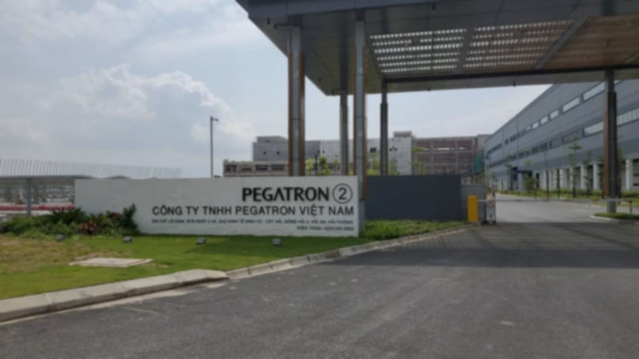
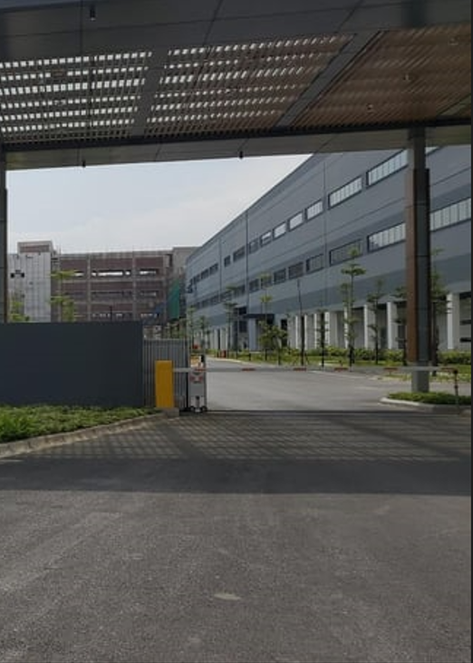
Thank You

